Slide 1
Human Computer Interaction
Fundamentals and Practice [ SWE - 431 ]
Gerard Jounghyun Kim
Chapter: 2
Specific HCI Guidelines
Mahfuzur Rahman Emon Lecturer, IICT, SUST

Slide 2


Human Computer Interaction
Chapter 2:
Principles are general, where guidelines are specific.
International Organization for Standardization (ISO) provide guidelines covering visual display, physical input devices, workplace ergonomics, tactile/heptic interactions.
Guidelines can be divided into two categories:
Domain specific ( Specific to user, platform etc )
General HCI Design
Guidelines can be relevant and common across the different categories.
Eg. guidelines for e-commerce application might also address different general HCI design issues such as display layout, how to solicit input, how to promote vendor-specific styles, and how to target for a particular user group.

Slide 3
Human Computer Interaction
Chapter 2:
Examples of Criteria/Categories for HCI Guidelines
Criteria | Main Categories | Examples
User Type | Age/generation Disability/accessibility Gender Consumer group Occupation Culture/country | Kids, elders, visually challenged, baby boomers, students, parents, East asians, atheletes etc
Platform/system setup | Mobile/handheld Desktop Large display/virtual reality Embedded Public installation Operating system/network | Smartphone, padlike device, desktop, kiosk, embedded OS, cloud based, navigation systems, personal game players, MP3 players, e-book, etc.

Slide 4
Human Computer Interaction
Chapter 2:
Examples of Criteria/Categories for HCI Guidelines
Criteria | Main Categories | Examples
Vendors/organizations | Private Public | NASA, Korea University, Android™, iOS, Windows® XP, etc.
Interface style/ modality/technology | WIMP (windows, icon, mouse, pointer) Non-WIMP 3-D Multimodal | Voice/aural, gesture, single/ multitouch, tactile/haptic, multimodal, menu driven, GUI/ widgets, visual perception, etc.
Task/operational context | Location/place Time Noise/lighting Bodily constraints | Office, outdoor, road/street, home, automobile, subway, classroom, eyes free, hands free, handedness, etc.

Slide 5
Human Computer Interaction
Chapter 2:
Examples of Criteria/Categories for HCI Guidelines
Criteria | Main Categories | Examples
Applications | Game Media/information Electronic commerce Design/editing Social network service
General HCI design | Display layout Information structure/navigation Soliciting input Information/output visualization Design process and practices User experience General aesthetics

Slide 6
Human Computer Interaction
Chapter 2:
Still hard to apply guidelines into the HCI design.
Even though guidelines are much more specific than the principles, it is still not very clear how to reflect them into the HCI design in a concrete and consistent manner
Tidwell’s guidelines address many category of the HCI issues illustrating specific UI examples with description what it does, why and when it should be used. Here we will discuss few examples.

Slide 7
Human Computer Interaction
Chapter 2:
Visual Display Layout (General HCI Design)
Organizing and allotting relevant information in one visible screen is concerning.
Generally one should try to:
Organize the display layout based on information content. ( importance, sequence, functionality )
Divided into proper sections
Attention grabbing
Visually pleasing ( align and with restricted use of colors )
On the next page, we will see the summarized gui for web-page layout put-forth by the US Department of Health and Human Services.

Slide 8
Human Computer Interaction
Chapter 2:
Guidelines | Explanation
Avoid cluttered displays | Create pages that are not considered cluttered by users
Place important items consistently | Put important, clickable items in the same locations and closer to the top of the page, where their location can be better estimated
Place important items at top center | Put the most important items at the top center of the web page to facilitate users finding the information
Structure for easy comparison | Structure pages so that items can be easily compared when users must analyze those items to discern similarities, differences, trends, and relationships
Establish level of importance | Establish a high-to-low level of importance for information and apply this approach throughout each page on the website

Slide 9
Human Computer Interaction
Chapter 2:
Guidelines | Explanation
Optimize display density | To facilitate finding target information on a page, create pages that are not too crowded with items of information
Align items on a page | Visually align page elements, either vertically or horizontally
Set appropriate page lengths | Make page-length decisions that support the primary use of the web page
Choose appropriate line lengths | If reading speed is most important, use longer line lengths (75–100 characters per line); if acceptance of the website is most important, use shorter line lengths (50 characters per line)
Use frames when functions must remain accessible | Use frames when certain functions must remain visible on the screen as the user accesses other information on the site

Slide 10
Human Computer Interaction
Chapter 2:
Information Structuring and Navigation (General HCI Design)
Single display is insufficient to encompass all the required information or to control UI of the application.
Structuring the information and making easy to move among items is must for high usability.
This is closely related to the principle of Understanding the Task.
Understanding the task involves identifying subtask sequences and actions, each linked to input or output information. The task structure, action sequence, and content organization guide interaction flow, ensuring optimal information and control timing.

Slide 11
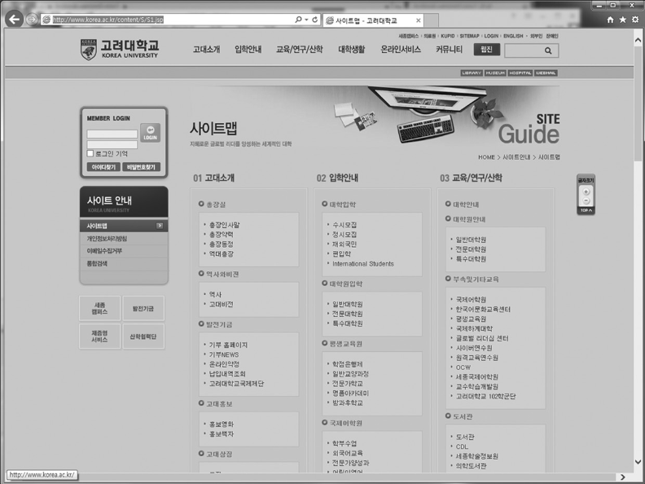
Human Computer Interaction
Chapter 2:
An example of site map for a website

Slide 12
Human Computer Interaction
Chapter 2:
Fast and easy navigation is also important to enable users to find the needed action and information quickly.
Designers should include site maps, and provide effective feedback on the user’s location within the site.
To facilitate navigation designers should
Differentiate and group navigation elements
Use appropriate menu types
Use descriptive tab labels
Provide clickable list of page contents on long pages
Add “glosses” on links when needed
Must not trap users on dead-end pages

Slide 13
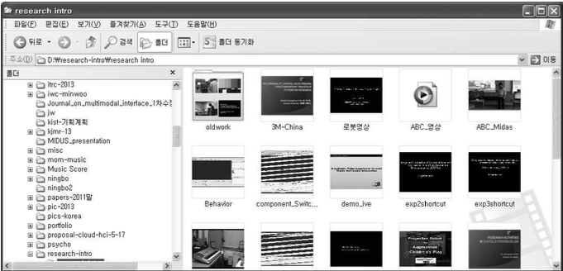
Human Computer Interaction
Chapter 2:
Example of two design patterns from Tidwell.
What: Put two side-by-side panels on the interface.
In the first, show a set of items that the user can
select at will; in the other, show the content of the
selected item.
When:
Display is large enough to show two separate panels at once
Presenting list of objects, categories or even
actions.
Allow users to see the overall structure of
list
The use of a two-panel selector, a design pattern for information structuring and facilitated navigation

Slide 14
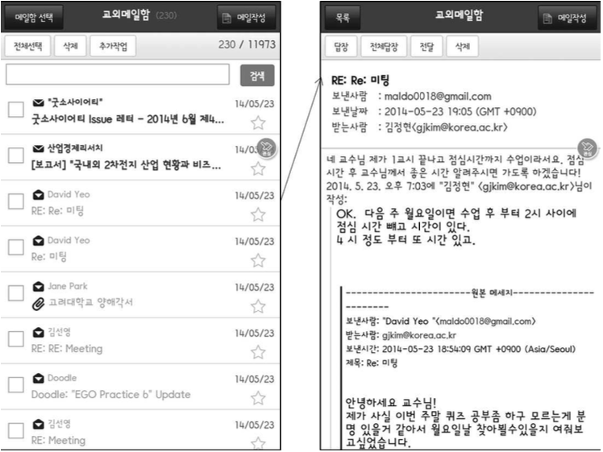
Human Computer Interaction
Chapter 2:
Example of two design patterns from Tidwell.
What: Show each of the application’s pages within a single window. As a user drills down through a menu of options, or into an object’s details, replace the window contents completely with the new page.
When:
Device with tight space restrictions
Application consists of many pages of content
Many application windows open - confuse average computer users.
The use of one-window drilldown as a designer pattern for content organization and fast navigation

Slide 15
Human Computer Interaction
Chapter 2:
Taking User Input ( General HCI Design )
Modern interfaces use GUI elements (window, text box, button, menu, forms, dialog box, icon), support techniques (autocompletion, deactivating irrelevant options, voice recognition), and devices (mouse, touch screen) for varied user input. UI designers must compose these methods considering design constraints (user type, task characteristics, operating environment).
Some guidelines for use in applying these input methods to facilitate data entry are:
Consistency of data-entry transactions: Similar sequences of actions should be used under all conditions (similar delimiters, abbreviations, etc.) Eg. Same date format across all the applications [ MM/DD/YYYY ]
Minimal input actions by user: Fewer input actions means greater operator productivity.
Proper use of single-key commands
Mouse selection
Auto-completion features
Selecting from list
Use default values
Avoid switching between keyboard and mouse

Slide 16
Human Computer Interaction
Chapter 2:
Minimal memory load on users: Use menus and button choices so that users do not have to remember a lengthy list of codes and complex syntactic command strings.
Compatibility of data entry with data display: The format of data-entry information should be linked closely to the format of displayed information (i.e., what you see is what you get).
Clear and effective labeling of buttons and data-entry fields: Use consistent labeling. Distinguish between required and optional data entry. Place labels close to the data-entry field.
Match and place the sequence of data-entry and selection fields in a natural scanning and hand-movement direction (e.g., top to bottom, left to right).
Do not place semantically opposing entry/selection options close together: For example, do not place “save” and “undo” buttons close together. Such a placement is likely to produce frequent erroneous input.
Situations become more complicated when other forms of input are also used such as touch, gesture, 3-D selection and voice. There are separate guidelines for them.

Slide 17
Human Computer Interaction
Chapter 2:
User with Disability ( User Type )
Web content Accessibility Guidelines (WCAG) explains how to make web content more accessible to people with disabilities. Summary of guidelines:
Perceivable
Provide text alternatives for non text content
Provide captions and other alternatives for multimedia
Create content that can be presented in different ways, including by assistive technologies, without losing meaning
Make it easier for user to see and hear content

Slide 18
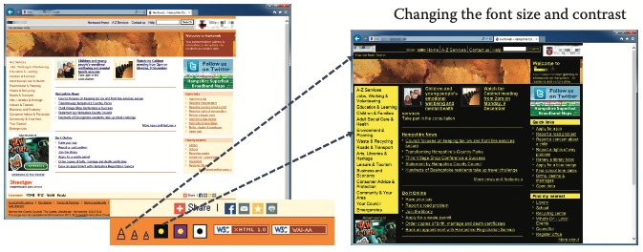
Human Computer Interaction
Chapter 2:
Adjustment feature for visually challenged users. The colors of the background and foreground text can be changed.

Slide 19
Human Computer Interaction
Chapter 2:
Operable
Make all functionality available from a keyboard
Give users enough time to read and use content
Do not use content that causes seizures
Help users navigate and find content
Understandable
Make text readable and understandable
Make content appear and operate in predictable ways
Help users avoid and correct mistakes
Robust
Maximize compatibility with current and future user tools

Slide 20
Human Computer Interaction
Chapter 2:
Mobile Device ( Platform type )
Fast status information
Minimize typing and leverage on varied input hardware
Fierce task focus [ maintaining a strong emphasis on the primary task at hand and minimizing distractions or unnecessary elements in a user interface ]
Large hit targets
Efficient use of screen space
Set of guidelines from Nokia developers’ home page
Enable shortcuts ( hot keys )
Keep the user informed of his or her actions
Follow the devices interface patterns

Slide 21
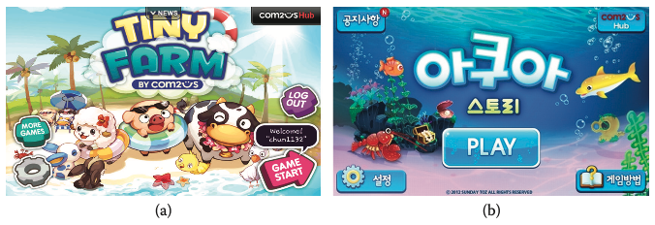
Human Computer Interaction
Chapter 2:
Comparison of two mobile game interfaces (the initial entry screen):
(a) information and object density is needlessly high and distracting
(b) simple and minimal layout, and object sizes fitted to ergonomic usage

Slide 22
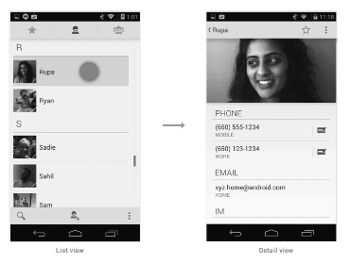
Human Computer Interaction
Chapter 2:
Android design guideline promoting the use of list views and detailed views (multiple
panels) to efficiently use the screen size of mobile devices.

Slide 23
Human Computer Interaction
Chapter 2:
Icons for apple ios and Fonts for Windows
Apple has published a design guideline document that details how application icons should be designed and stylized
Try to balance eye appeal and clarity of meaning in your icon so that it is rich and beautiful and clearly conveys the essence of your app’s purpose.
Investigate how your choice of image and color might be interpreted by people from different cultures.
Create different sizes of your app icon for different devices. For iPhone and iPod touch, both of these sizes are required

Slide 24
Human Computer Interaction
Chapter 2:
Windows’s guidelines for the choice of fonts and its size promote organizational styling and its identity and ultimately its consistency in user interfaces
Franklin Gothic is used only for text over 14-point size. It is used for headers and should never be used for body text.
Tahoma is used as the system’s default font. Tahoma should be used at 8-, 9-, or 11-point sizes.
Verdana (bold, 8 point) is used only for title bars of tear-off/floating palettes.
Trebuchet MS (bold, 10 point) is used only for the title bars of Windows (Figure 2.8).

Slide 25
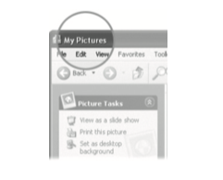
Human Computer Interaction
Chapter 2:
An example of Trebuchet font used for a window title bar.

Slide 26
Human Computer Interaction
Chapter 2:
Earcon design for Aural interface
Similar to visual icons, must capture underlying meaning
Draw attention for easy recognition
Should be designed to be intuitive
Blattner, Sumikawa and Greenberg suggest three types of earcons
Symbolic: Rely on social convention. Eg. applause for approval
Nomic: Physical. Eg. Door slam
Metaphoric: Based on capturing similarities. Eg. falling pitch for a falling object

Slide 27
Human Computer Interaction
Chapter 2:
Making calls in Automobiles ( Task )
Basic:
Car phones should operate like phones people have at home. Eg. The use of send, power to turn of or on.
Voice dialog
Verbal commands and button labels should use the same terms
Commands of interest include dial, store, recall and clear
Manual dialing
The store and recall buttons, used for similar functions.

Slide 28
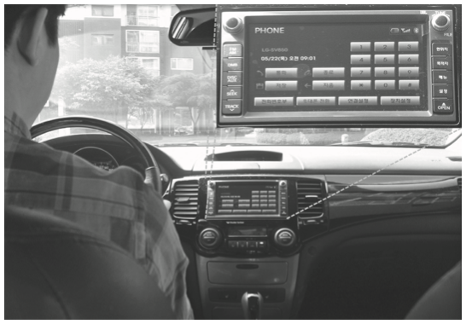
Human Computer Interaction
Chapter 2:
Phone interface for automobiles.

Slide 29
Human Computer Interaction
Chapter 2:
E-Commerce ( Application )
Kalsbeek has collected and formulated very extensive, detailed, and structured HCI guidelines for e-commerce applications with 404 guidelines structured in four groups - general, input/output forms, UI elements and checkout process.
Guidelines under the checkout process section:
Check-out should start at the shopping cart
Should be followed by gift options or shipping methods
Shipping address, billing address payment information collection from user
Order review
Order summary
Displaying a confirmation page

Slide 30
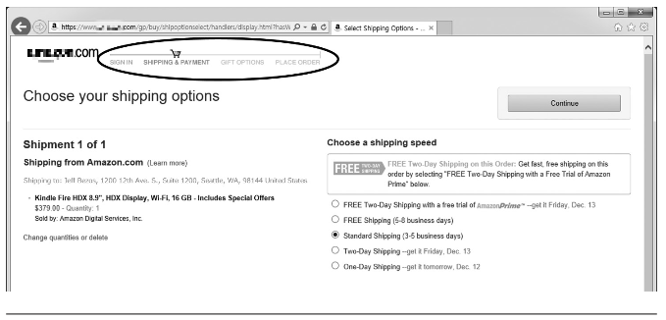
Human Computer Interaction
Chapter 2:
Status information (circled) shown in the process of a book purchase

